Slide 1
Confusion matrix
Confusion matrix is a simple table used to measure how well a classification model is performing.
It compares the predictions made by the model with the actual results and shows where the model was right or wrong.
This helps you understand where the model is making mistakes so you can improve it.
Confusion matrix plays major role to understand accuracy and performance of machine learning of classification problem.

Slide 2
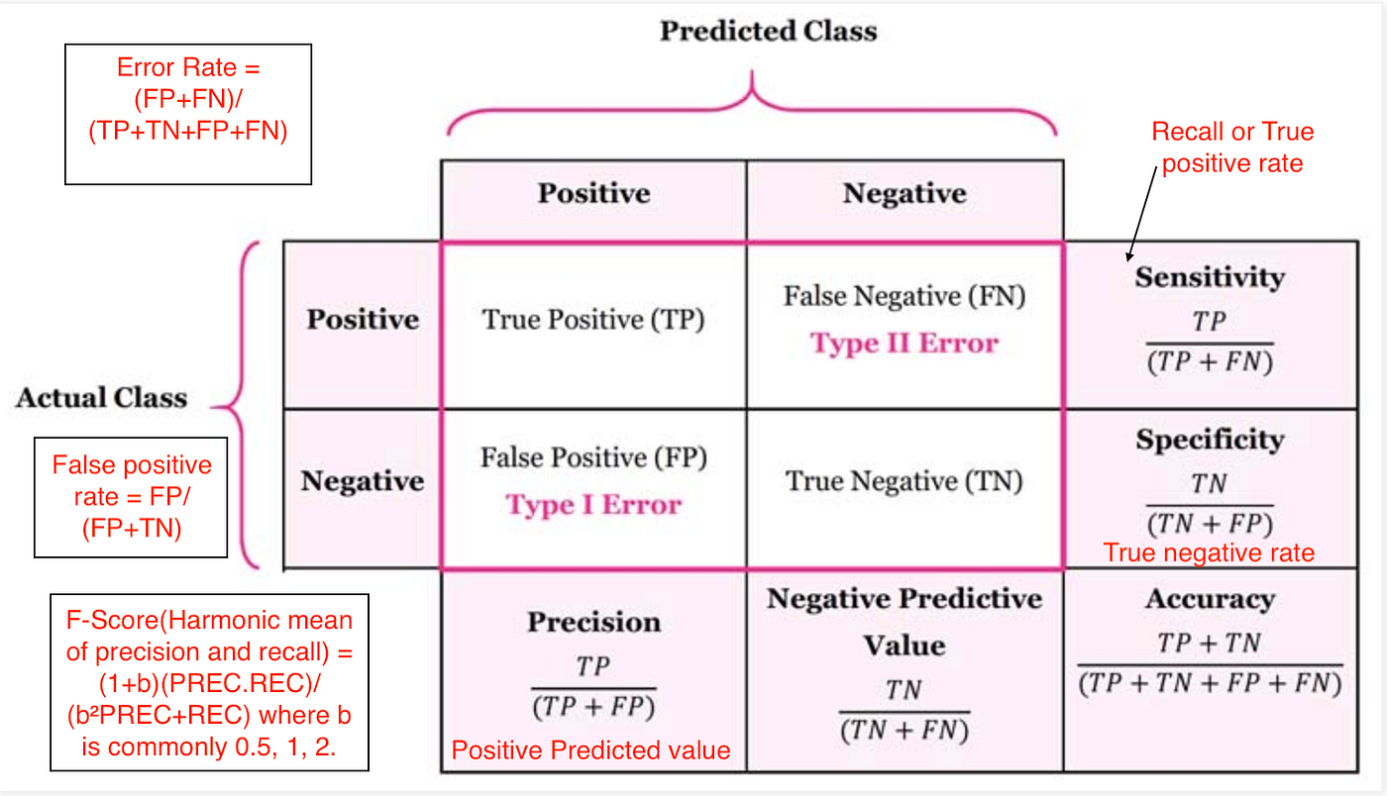
Confusion matrix

Slide 3
Confusion Matrix
A binary classifier predicts all data instances of a test data set as either positive or negative. This produces four outcomes-
True-positive(TP) — Correct positive prediction
False-positive(FP) — Incorrect positive prediction (Type I error)
True-negative(TN) — Correct negative prediction
False-negative(FN) — Incorrect negative prediction ( Type II error)

Slide 4
Confusion matrix
True Positive (TP)
The model correctly predicted a positive outcome i.e the actual outcome was positive.
Example: Sick person correctly diagnosed as sick
True Negative (TN)
The model correctly predicted a negative outcome i.e the actual outcome was negative.
Example: Healthy person correctly diagnosed as healthy
False Positive (FP)
The model incorrectly predicted a positive outcome i.e the actual outcome was negative. It is also known as a Type I error.
Example: Healthy person wrongly diagnosed as sick
False Negative (FN)
The model incorrectly predicted a negative outcome i.e the actual outcome was positive. It is also known as a Type II error.
Example: Sick person wrongly diagnosed as healthy

Slide 5


Performance metrics
Accuracy
Shows how many predictions the model got right out of all the predictions.
Overall correctness of the model
High accuracy does not always mean good performance (especially with imbalanced data)
Error Rate
Fraction of wrong predictions

Slide 6



Performance metrics
Precision (Positive Predictive Value)
Shows how many predicted positives are actually positive
Focus on the quality of the model’s positive predictions.
Important when false positives are costly
Recall / Sensitivity / True Positive Rate (TPR)
How many actual positives are correctly identified
Important when missing positives is dangerous (e.g., disease detection)
Specificity / True Negative Rate (TNR)
How many actual negatives are correctly identified
Important when false alarms should be minimized

Slide 7



Performance metrics
False Positive Rate (FPR)
Probability of falsely predicting positive
Used in ROC curve analysis
Negative Predictive Value (NPV)
How many predicted negatives are actually negative
F-Score (Fβ-score)
Harmonic mean of Precision and Recall
β = 1 → F1-score (Precision and Recall equally important)
β > 1 → Recall more important
β < 1 → Precision more important

Slide 8
Problems
Given a confusion matrix with TP = 40, TN = 45, FP = 5, and FN = 10:
Calculate the standard performance measures.
Analyze how increasing the False Negative count would affect Recall and F1-score, while keeping other parameters constant.
Interpret the suitability of this classifier for a medical diagnosis application, providing reasons.
Actual \ Predicted | Positive | Negative | Total
Positive | TP = 40 | FN = 10 | 50
Negative | FP = 5 | TN = 45 | 50
Total | 45 | 55 | 100

Slide 9
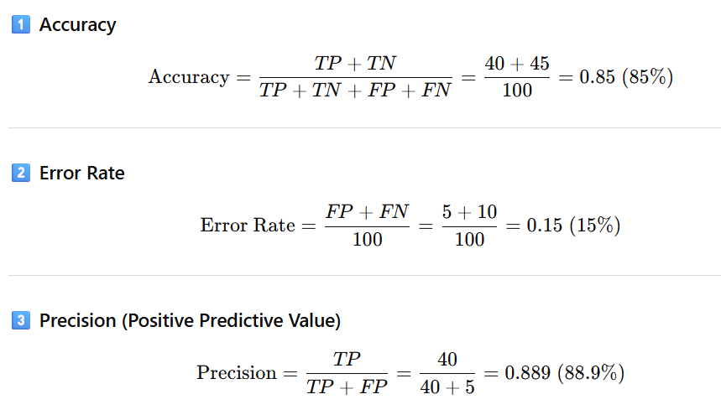
Problems

Slide 10
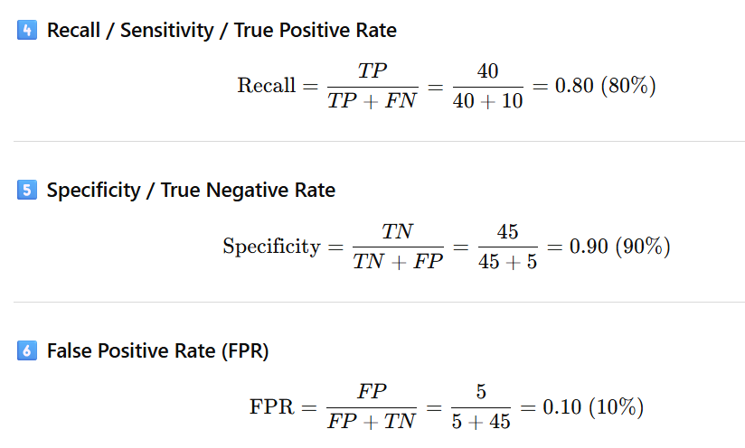
Problems

Slide 11
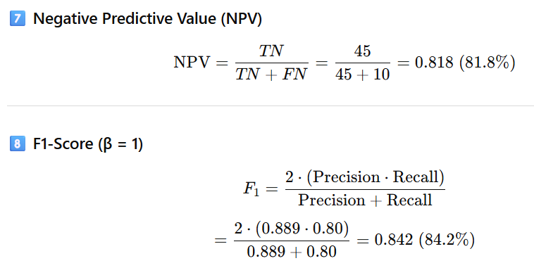
Problems

Slide 12
Problems
Analyze how increasing the False Negative count would affect Recall and F1-score, while keeping other parameters constant.
If FN increases, the denominator increases, TP remains constant.
More actual positive cases are being misclassified as negative, so the model becomes worse at detecting positive cases.
If Precision stays high, a drop in Recall significantly lowers the F1-score.
Interpret the suitability of this classifier for a medical diagnosis application, providing reasons.
The classifier has a recall of 80%, meaning some diseased patients are misclassified as healthy (False Negatives). Since medical diagnosis requires minimizing False Negatives, this classifier is not ideal, and higher sensitivity is needed for safe clinical use.

